Slide 1
Summer Day Camp Online Registration Process 2025
Adaptive Youth & Teen Camp, Duo Quest Camp, Kapers & Kids Camp, Rockin’ R Camp, and Travel Adventure Camp

Slide 2
Online Registration for Summer Day Camps can be found at www.RoundRockRecreation.com
2025 Summer Registration opens Tuesday, March 4th at midnight
When registering online this year, you will have the option to pay in full for all the weeks registering for or take part in a payment plan.
If you register for payment plan online, you will have the option to set up auto-billing for your future payments or to set up installment bills.
STEPS TO REGISTER FOR SUMMER DAY CAMPS:
On Main Page, click “Sign In” in top right corner

Slide 3
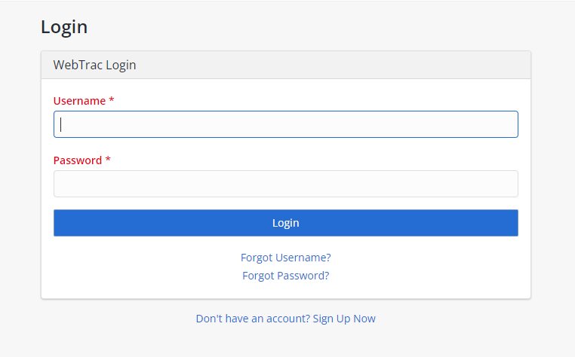
STEPS TO REGISTER FOR SUMMER DAY CAMPS:
Login to your Account
On February 13, 2023, we switch to a new software system, not all accounts were transferred over. You can start to create a new account and the system will alert you if an account exists with your email address.
If you do not have an account, you will need to create one before you can start the registration process.

Slide 4
STEPS TO REGISTER FOR SUMMER DAY CAMPS:
Once logged in, you can navigate to the Summer Day Camps by either selecting “Programs” or the “Find a Program and Register Online”
You can also narrow down your results by selecting “Adaptive & Inclusive” for the Adaptive Camps or “Day Camps” for Duo Quest, Kapers and Kids, Rockin’ R or Travel Adventure Camps.

Slide 5
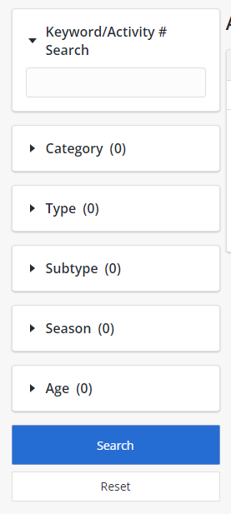
STEPS TO REGISTER FOR SUMMER DAY CAMPS:
You can narrow down your search results by using the search areas on the left side of the screen.
You can use the Keyword/Activity # Search to search by camp/program name
Or you can search by Category to view the different categories of programs.

Slide 6
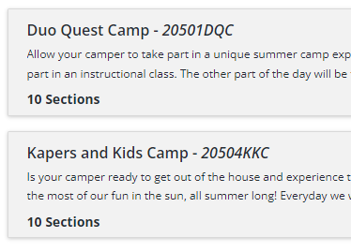
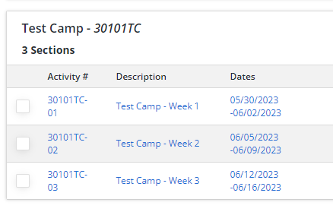
STEPS TO REGISTER FOR SUMMER DAY CAMPS:
When you find the camp that you are interested in you can click on the camp to open the list of available sections/weeks for that camp.

Slide 7
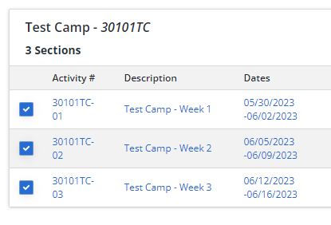
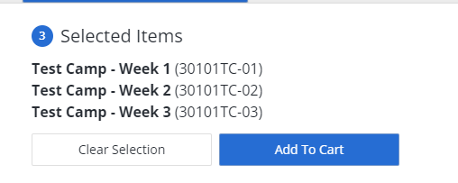
STEPS TO REGISTER FOR SUMMER DAY CAMPS:
Select any sections that you are interested in to add them to the “Selected Items” at the bottom or your screen.
Once you have the items that you are interested in selected, click “ Add To Cart”

Slide 8
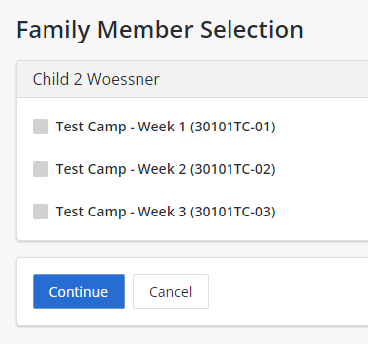
STEPS TO REGISTER FOR SUMMER DAY CAMPS:
Any eligible Family Members on the account will appear on the next screen with the option to select which items you would like to select for each individual.
Once all items that you are interest in are selected click “Continue”

Slide 9
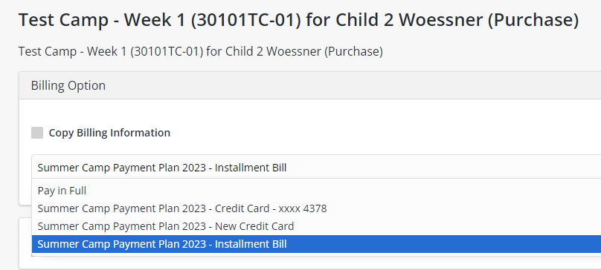
STEPS TO REGISTER FOR SUMMER DAY CAMPS:
On the next screen, you can choose to register using a payment plan or if you would like to pay in full.
If you would like to pay in full, select “Pay in Full”
If you would like to sign up for a payment plan, you can select to have the future bills auto-billed by selecting “Summer Camp Payment Plan 2023 – New Credit Card”
If you would like to sign up for a payment plan but don’t want to be set up for auto-billing, you will select “Summer Camp Payment Plan 2023 – Installment Bill”

Slide 10
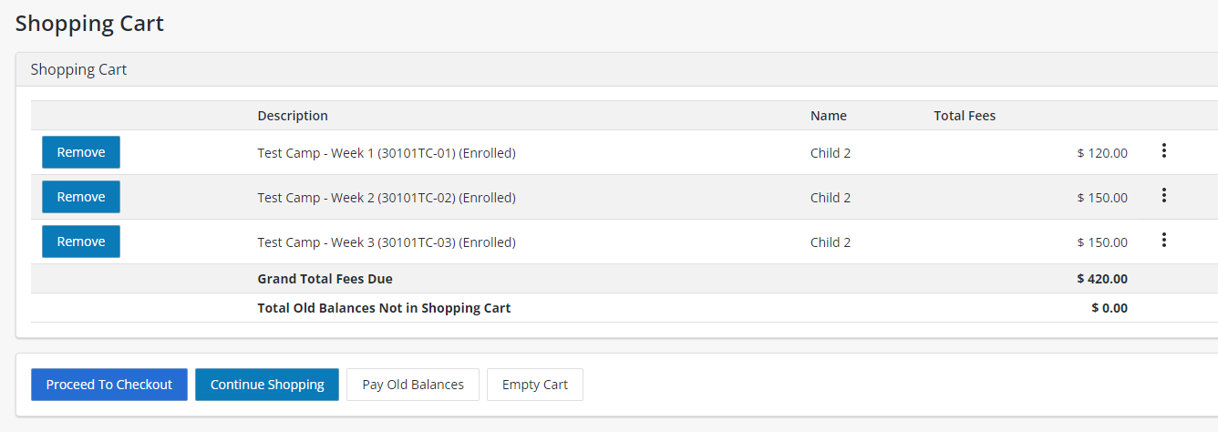
STEPS TO REGISTER FOR SUMMER DAY CAMPS:
The next screen will review the weeks that you just selected. If you would like to add additional weeks select “Continue Shopping” otherwise select “ Proceed to Checkout”

Slide 11
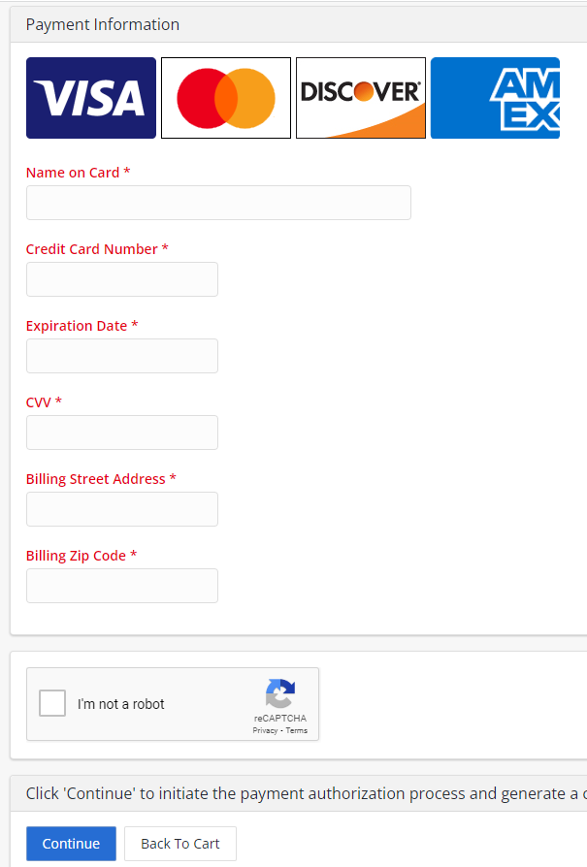
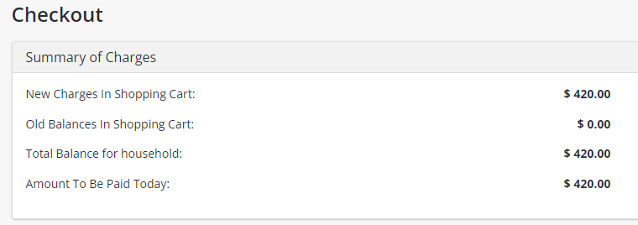
STEPS TO REGISTER FOR SUMMER DAY CAMPS:
This will bring you to the final screen. Your total due for the time of registration will be shown in the cart. If you are registering for a payment plan, only the down payment amount will be shown in the summary of charges.
To complete the registration, fill out the payment method of your choosing and click “Continue”

